Slide 1

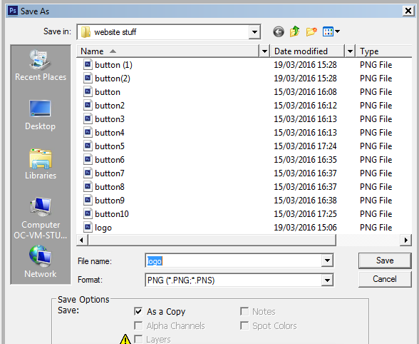
This is the logo we use for our websites, this is used in the footer of every page on my website so it needs to be optimised for the website so that it will not affect the loading time of the website.
This screenshot shows me saving the logo as a PNG file to optimise its use on the website, I did this because a PNG file supports lossy compression which will help to increase the load times for it on the website.

Slide 2

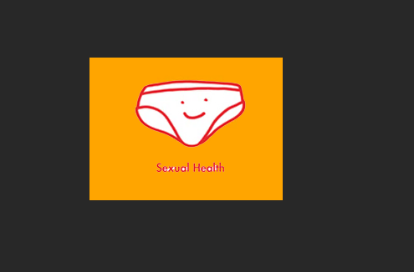
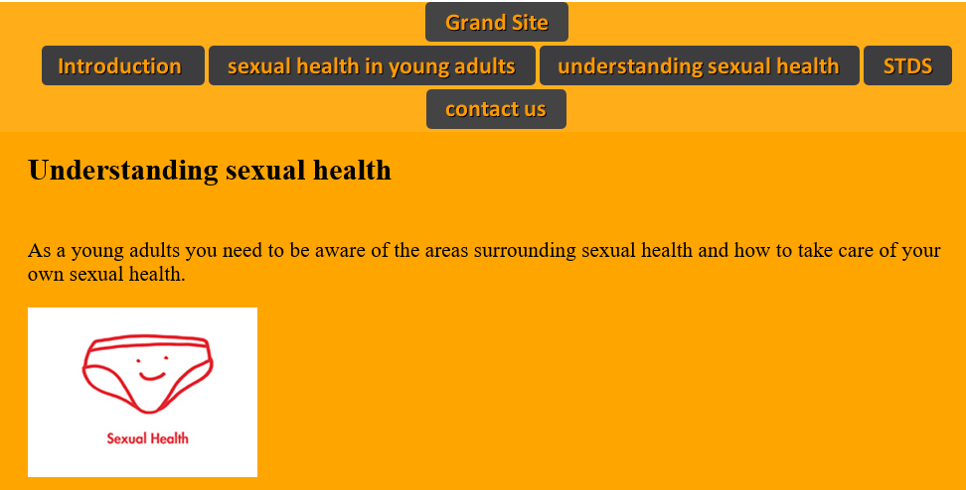
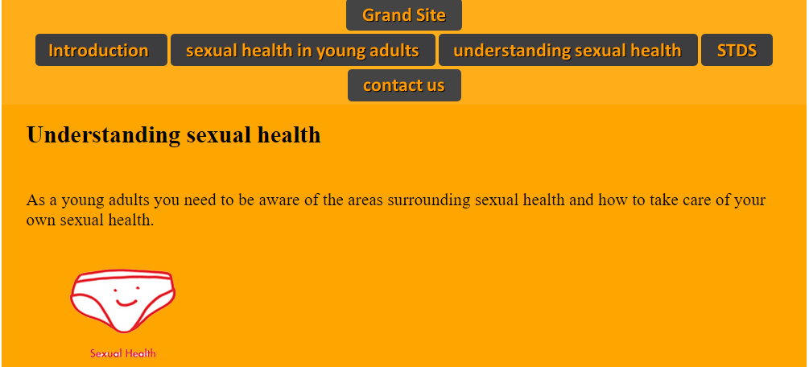
The next image I used on my website is this.
This is a jpg file which is already small and quickly loads.
To make this more suitable for the website I changed the colour background in Photoshop to make it better blend into the background.
To do this I used the paint bucket tool to fill in to match the background of the website
These are the before and afters off the image on the website
As you can see this is a minor change but it blends much better with the website

Slide 3

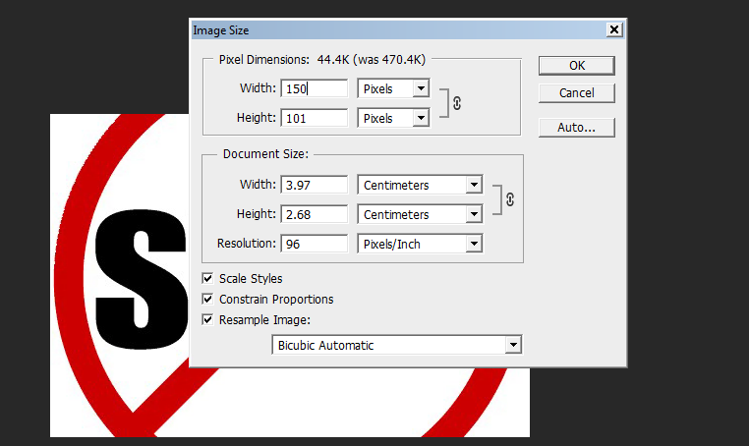
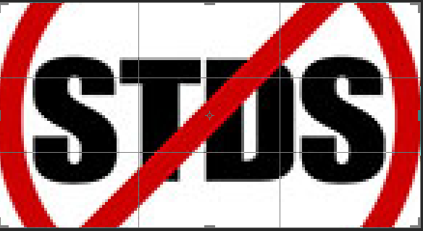
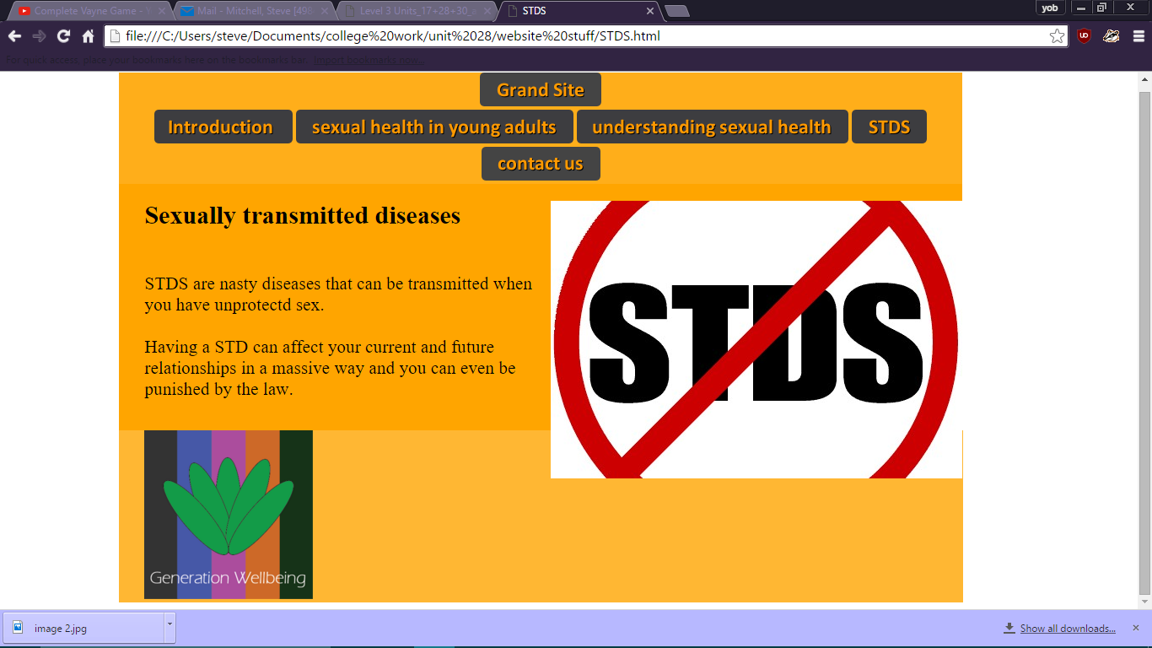
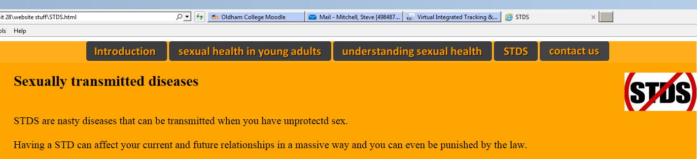
The next image is this
this image is 488x329, this is a rather large image on the website and could take a while to load.
To change this I went into the image options and then changed the image size to one
That would better load on the website and wouldn’t take up too much room.
Once I has reduced the size of the image I decided to crop out the white part next to the red circle so there is less white on my webpage.
(this image shows the put outline of where to crop
As you can see it fits the webpage much better and it also should load much faster because o the reduced size. The image itself will still be noticeable when the reader is reading so although the size is reduced it still is effective.

Slide 4

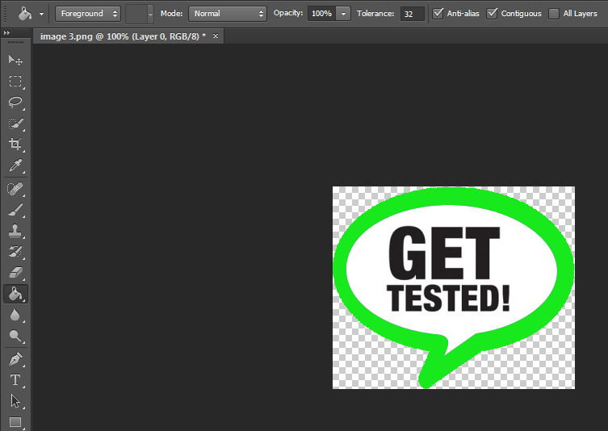
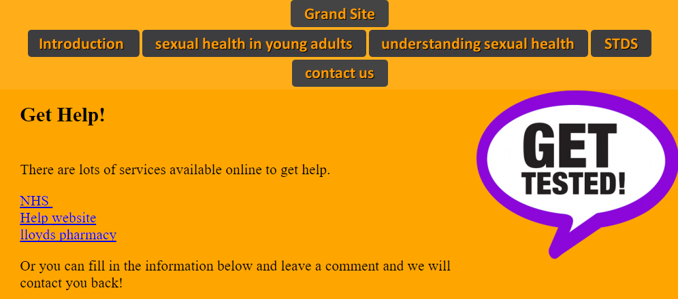
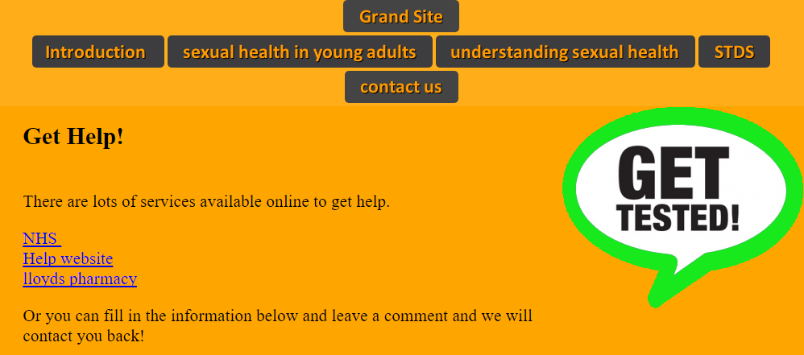
For this image I was unsure on how I could optimise it for the website because it already fits the website really well, so I decided to try and use some tools and options to improve the image.
The first tool I used was the paint bucket tool to change the colour of the outer part from purple to green because green better suits the idea of being healthy.
I then went onto filters and looked at the filter options and looked at the sharpen options and I sharpened the edges so it will stand out more against the orange background on the webpage.
Although this is a minor it helps the image to stand out more on the webpage.
It was already a PNG file so it was already optimised for the webpage.

